Slide 1
The Heuristic Function - Recap
The Cost of a Node B
  Assume we are trying to find a path from A to C
The Cost of C if C is terminal node on path from A is
  Cost of going from A to B
    Call this “G”
  Cost of going from B to C
    Call this “H” (stands for heuristic)

Slide 2
The Heuristic function
As we are at B we know what the cost of G is
We do not know the cost from B to C!
  We must estimate this somehow (heuristically)
Total Cost of Path
    Called “F”
  Cost of path from A to B plus cost of path from B to C
F = G + H

Slide 3
The Heuristic Function
It has been proven that
  If the heuristic (H) is guaranteed not to over estimate the Actual cost (admissible) then
  When using A* algorithm the first solution found will be the optimal one!
  e.g. if Estimate H is set to 0 then it is always an underestimate!
  But the more accurate it is the faster the search is
Check out http://www.redblobgames.com/pathfinding/a-star/introduction.html for some online examples in Python.
Notes:
http://www.redblobgames.com/pathfinding/a-star/introduction.html

Slide 4
A* Pathfinder - Recap
Path 1 example: The function does not yet know the path from this cell to cell
G, so it estimates the length by using a straight line (4.12)
f(n) = 4.12 + 2.41 = 6.53
 |  | S |  |  |  |  |  | G
4.12
1.00
1.41
2.00
6.32
Path 2 example: The function does not yet know the path from this cell to cell
G, so it estimates the length by using a straight line (6.32)
f(n) = 6.32 + 2.00 = 8.32
Notes:
Sqrt(1*1 + 1*1) = sqrt(2) = 1.41
Sqrt(1*1 + 4*4) = sqrt(17) = 4.12
Sqrt(2*2 + 6*6) = sqrt(40) = 6.32

Slide 5
A* Algorithm
For each node we store:
  F, G and H values (as struct or class)
  Pointer to Parent Node
If each node holds pointer to parent node then we can use this to trace path back through nodes

Slide 6
A* Algorithm
We store two lists
  Open List
    Nodes with all successors not yet checked
  Closed List
    Nodes with all successors already checked
These are linked lists of Node structs (or classes)
They should be (will be) sorted!
  Faster retrieval of best path

Slide 7
A* Algorithm
Start by setting up our variables
  Assign F, G and H values to start node
    How?
  Initialise closed-list to empty
    No nodes checked yet
  Add start node to open-list
    Starting point of search
Then begin search loop (see next slide)

Slide 8
A* Algorithm
Repeat
  Take best node B from open list
  If open list is empty then there is no solution
  If b == Goal then solution found
  For each node N connected to B:
    Assign F, G and H values for N
    If N is in open or closed list then
      If new Path is better then
        Replace old entry for N with new one
      Else
      Add N to open list
    Add B to Closed List

Slide 9
A* Search
Used for path finding in EVERY game
How do we find an appropriate Heuristic?
  Problem Dependent
For Geographical search
  Use straight line distance from current node to goal
    Always less that actual value but sometimes very close!
Edges can have weights attached
  e.g. Paving < Grass < Forest < Swamp < etc.

Slide 10
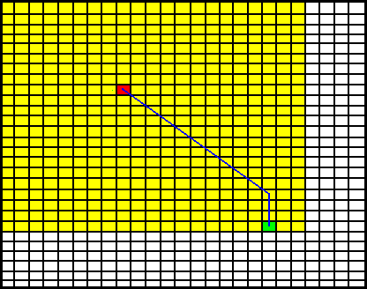
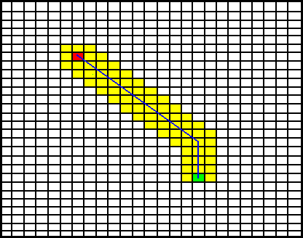
Pathfinding
Dijkstra’s Algorithm A* Algorithm
A* is a directed algorithm (Dijkstra’s is undirected), so
A* searches much less area and the result is faster searching.
When might Dijkstra’s outperform A*?

Slide 11
A* Search - Enhancements
Typically, Open and Closed lists composed of NodeRecords
Struct NodeRecord:
  node
  connection
  costSoFar
  estimatedTotalCost
Nodes are then moved between open and closed lists
Algorithm searches for nodes in lists
Node Array A*
Instead all node records put into a “Node array”
  However, some may never be needed (trade-off against memory use)
  Nodes numbered sequentially (direct lookup instead of search)
  Add a category field (“UNVISITED”, “OPEN”, or “CLOSED”)
  Closed list becomes irrelevant

Slide 12
IDA* - Iterative Deepening A*
Richard Korf (Columbia University - 1985)
Similar to depth first iterative deepening
  With Iterative deepening searches are performed to increasing depth levels
  With IDA* the searches are bound NOT by depth but by a limit on the values of nodes!
  Branches may be searched to different depths

Slide 13
IDA* Algorithm
Bound = f(Start Node)
Repeat
Do depth first search until path values exceed bound or goal found
  //(i.e. find all paths < bound)
If goal found then exit with solution
Else
Compute new bound as minimum of the f values of nodes that exceeded
the bound
Bound = {min f(n)| n found by search and f(n) > Bound}
End if
End repeat

Slide 14
IDA* Algorithm
May be slightly slower than A*
  Repeats paths
Beneficial when problem is memory constrained
  Doesn’t remember prior work
  For really big searches A* could run out of memory
If the heuristic function is admissible, IDA* finds an optimal solution
Notes:
An admissible heuristic never overestimates the cost of reaching the goal.

Slide 15
Improved IDA*
A* + IDA*
  Perform A* to a certain depth
  Then perform IDA*
Parallel IDA*
  When processing the child nodes use separate threads
  Each thread needs to return the min f cost for the next search level

Slide 16
A*mbush
Pronounced A* ambush
Extending A* to implement coordination
  Multiple NPCs attacking the same location/character
  Close NPCs will find the same search path
    No route diversity
    Escape paths left open
Aim is to produce an ambush behaviour
  Modify the evaluation function to favour path diversity
  Check what the other NPCs are doing
What about the order in which the NPCs search?
Check out the paper on blackboard:
A*mbush Family: A* Variations for Ambush Behavior And Path Diversity Generation

Slide 17
Heuristics in everyday life
Disclaimer: non academic source but nonetheless food for thought.
"Consistency heuristic" is a heuristic where a person responds to a situation in a way that allows them to remain consistent.
"Educated guess" is a heuristic that allows a person to reach a conclusion without exhaustive research. With an educated guess a person considers what they have observed in the past, and applies that history to a situation where a more definite answer has not yet been decided.
"Common sense" is a heuristic that is applied to a problem based on an individual’s observation of a situation. It is a practical and prudent approach that is applied to a decision where the right and wrong answers seems relatively clear cut.
"Contagion heuristic" causes an individual to avoid something that is thought to be bad or contaminated. For example, when eggs are recalled due to a salmonella outbreak, someone might apply this simple solution and decide to avoid eggs altogether to prevent sickness.
"Familiarity heuristic" allows someone to approach an issue or problem based on the fact that the situation is one with which the individual is familiar, and so one should act the same way they acted in the same situation before.
"Scarcity heuristic" is used when a particular object becomes rare or scarce. This approach suggests that if something is scarce, then it is more desirable to obtain.
"Affect heuristic" is when you make a snap judgment based on a quick impression. This heuristic views a situation quickly and decides without further research whether a thing is good or bad. Naturally, this heuristic can be both helpful and hurtful when applied in the wrong situation.
Read more at http://examples.yourdictionary.com/examples-of-heuristics.html#oIAhBzb3ui9FeBb7.99

Slide 18
Heuristics in everyday life
Comment:
Educated Guess: As you approach a roped-off section of a museum without written instructions and without a clear pathway to walk, you could use the Educated Guess Heuristic to conclude that you should not walk past it (beyond it) and that finding an alternate way would be better.
Reply:
However it may be that you are on the wrong side of the rope and the roof is about to fall on your head. The absence of a clear pathway may have resulted from a museum guide's efforts to move priceless treasures out of harms' way. You may not be well enough educated in emergency procedures nor in structures nor in those priceless treasures to recognize them as such. Heuristics are limited and flawed if data is ignored.
Reply:
If I were on the wrong side of the rope, it seems that I would have unusual access to the area and would be employed and understand the happenings of the museum. Being on the incorrect side of the rope is a silly notion as ropes are often dictated by there applicator. Heuristics doesn't ensure that the 'correct' decision is always reached - it's simply that one is made and learned from. There are plenty of things to learn from an 'incorrect' guess.

